Slide 1


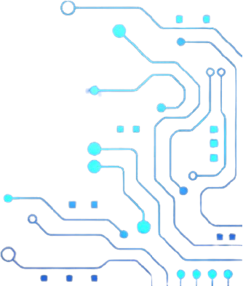

THE INTERNET OF THINGS
Olwethu Mokoena

Slide 2
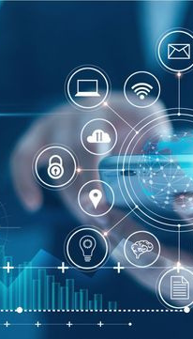

WHAT IS IOT?
The Internet of Things is the concept of connecting any device with an on/off switch to the internet.
It is the network of physical objects that are embedded with sensors, software and other technologies for the purpose of connecting and exchanging data with other devices and systems over the internet.

Slide 3
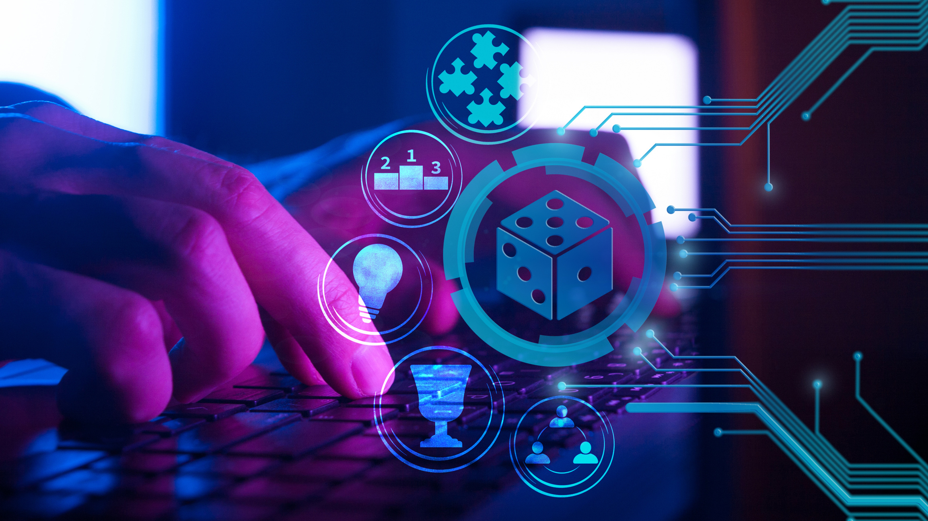
HISTORY OF IOT
Examples of interrelated electronic devices date back to as far as the 19th century, where the telegraph (1st landline) was invented with the ability to transmit info by coded signals over a large distance. A group of prominent researchers began experimenting with ways to connect computers and systems.
The first radio voice transmission, also known as “wireless telegraphy” took place on the 3rd of June 1900, providing a necessary component for developing the Internet of Things.
The Internet began as part of Defense Advance Research Projects Agency (DARPA) in 1962, which later changed to Advanced Research Projects Agency Network (ARPANET) in 1969.
The history of the Internet of Things is characterized by technological advancements, increasing connectivity, and the expansion of smart, interconnected devices across different industries and applications.

Slide 4

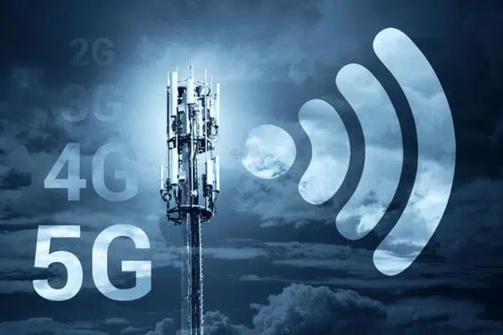
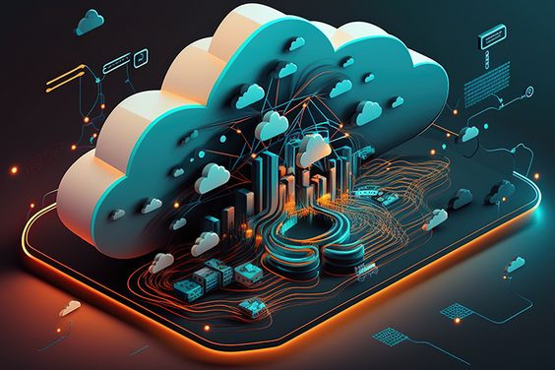
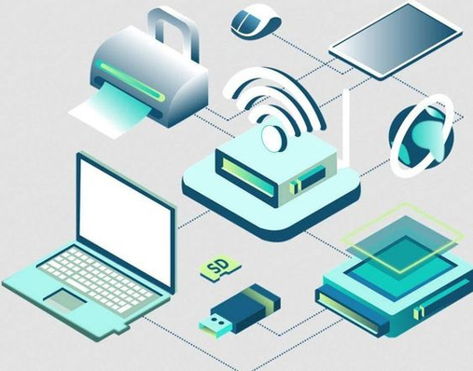
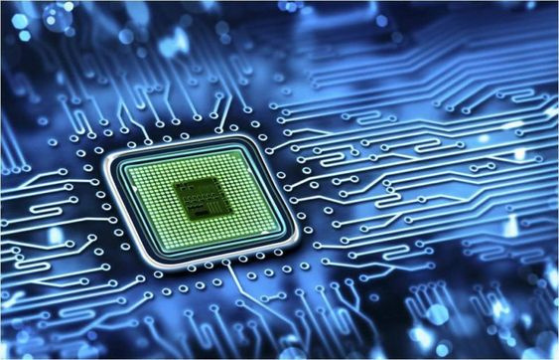
WHAT TECHNOLOGIES ENABLE IOT?
WIRELESS SENSOR NETWORKS contain distributed devices with sensors used to monitor environmental and physical conditions
NETWORK PROTOCOL AND INFRASTRUCTURES
enable network connectivity and linking to applications.
They allow devices to exchange data over the network.
CLOUD COMPUTING allows users to access resources from webservers, databases, storage, any device and any software over the internet.
EMBEDDED ELECTRONICS AND HARDWARE SYSTEMS are a combination of hardware and software used to perform special tasks. They include storage devices, networking units and input/output units.
wireless sensor networks
cloud computing
network protocols
embedded electronics

Slide 5
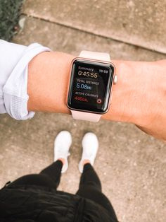
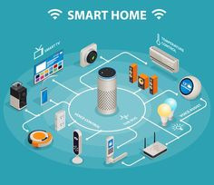
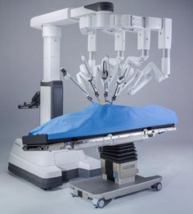
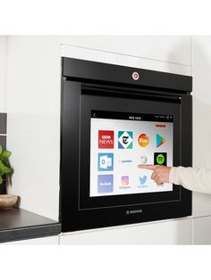
IMPACT OF IOT
The Internet of Things increased the convenience of automating both tedious tasks, and tasks that require advanced knowledge.
The impact of IoT varies depending on our lifestyle and work environment. It helps improve our quality of life and well being with fitness and sleep trackers. It increases our safety with the help of smart security systems, some which are able to detect smoke/fire ASAP.
IoT also plays a big role in technological advancements in healthcare and medicine by tracking a patient’s health and progress, to surgical robots that aid with complicated surgeries.

Slide 6
FUTURE IMPACT OF IOT
We’ve already witnessed dramatic changes in what IoT is capable of. According to zipitwireless.com, the number of IoT devices by 2030 is expected to be over 24 billion. Developments in 5G, AI and Advanced Analytics are expected. Other potential developments include Smart cars and better road safety and Smart cities with government adoption of IoT.
SOURCES
https://www.techtarget.com/iotagenda/definition/Internet-of-Things-IoT
https://www.oracle.com/za/internet-of-things/what-is-iot/
https://www.britannica.com/science/Internet-of-Things
https://www.dataversity.net/brief-history-internet-things/
https://za.pinterest.com/
https://freeeway.com/top-4-iot-enabling-technologies/
https://www.geeksforgeeks.org/internet-of-things-iot-enabling-technologies/
https://www.solum-group.com/what-is-the-impact-of-iot-on-our-daily-lives/
https://www.zipitwireless.com/blog/future-of-iot-what-to-expect-in-the-next-5-years

